Slide 1
Lecture-8 Introduction to Digital Signal Processing: 2

Slide 2
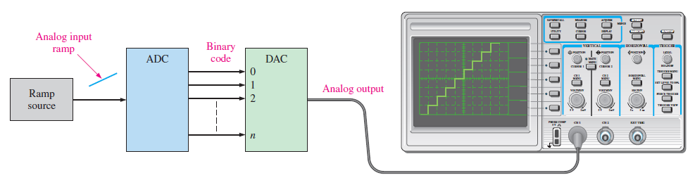
Introduction
Digital to analog conversion is an important part of digital signal processing.
Once the digital signal has been processed, it is further needed to be converted back to the analog form.
A Digital to Analog Converter (DAC) is an electronic device, often an integrated circuit, which converts a digital signal to its corresponding analog signal.
Two types of DAC will be studied:
Binary Weighted DAC
R-2R Ladder DAC

Slide 3
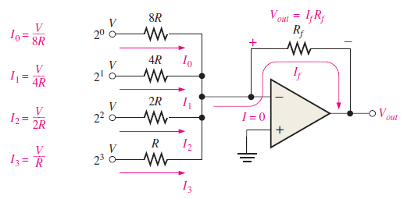
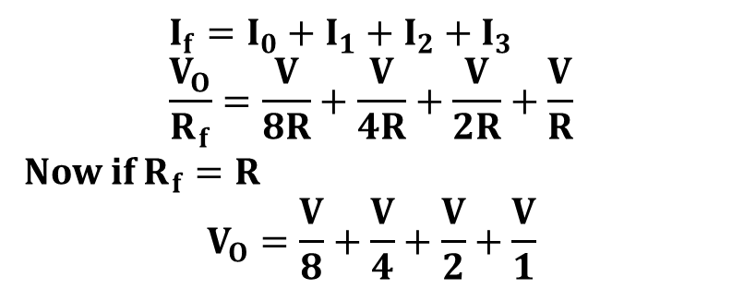
Binary Weighted DAC
The figure shows a 4-bit DAC.
The resistors have a specific value depending on the binary weights.
The resistor corresponding to MSB have the lowest value
The resistor corresponding to LSB have the highest value.
The output depends on the presence or absence of current in the branches.
$$I_{f}=I_{0}+I_{1}+I_{2}+I_{3} \\ \frac{V_{O}}{R_{f}}=\frac{V}{8R}+\frac{V}{4R}+\frac{V}{2R}+\frac{V}{R}$$
Now if $R_{f}=R$
$$V_{O}=\frac{V}{8}+\frac{V}{4}+\frac{V}{2}+\frac{V}{1}$$

Slide 4
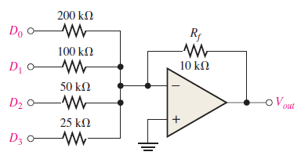
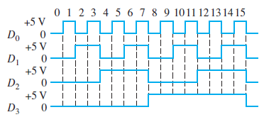
Binary Weighted DAC
Determine the output of the DAC if the waveform representing a sequence of 4-bit numbers are applied to the inputs. Input $D_{O}$ is the least significant bit(LSB)

Slide 5

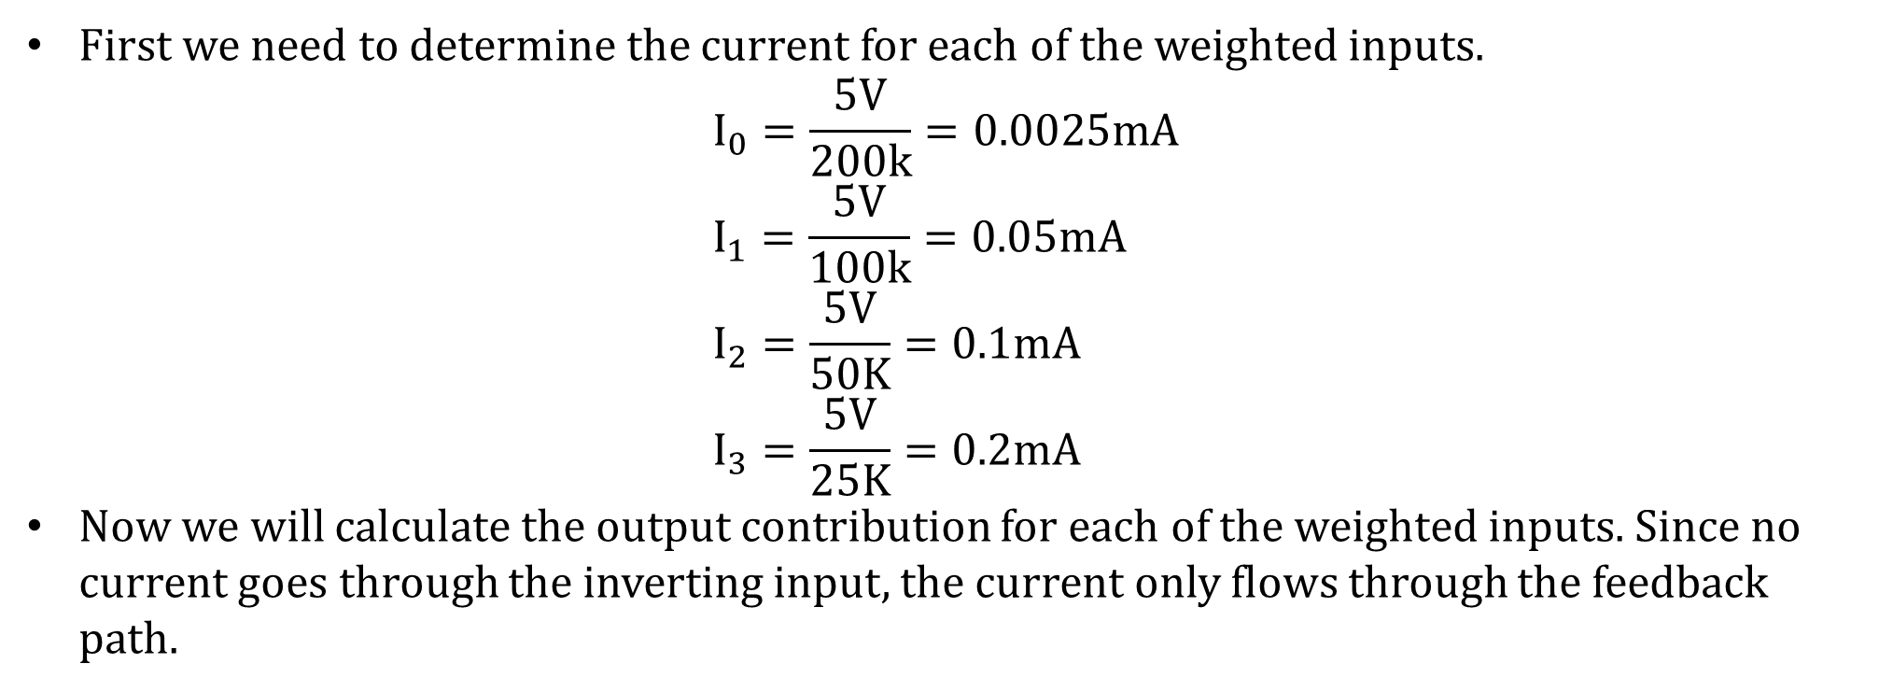
Binary Weighted DAC
First we need to determine the current for each of the weighted inputs.
$$I_{0}=\frac{5V}{200k}=0.0025mA \\ I_{1}=\frac{5V}{100k}=0.05mA \\ I_{2}=\frac{5V}{50K}=0.1mA \\ I_{3}=\frac{5V}{25K}=0.2mA$$
Now we will calculate the output contribution for each of the weighted inputs. Since no current goes through the inverting input, the current only flows through the feedback path.
$$V_{O\left(D0\right)}=\left(10k\right)\left(−0.025mA\right)=−.25V \\ V_{O\left(D1\right)}=\left(10k\right)\left(−0.05mA\right)=−0.5V \\ V_{O\left(D2\right)}=\left(10k\right)\left(−0.1mA\right)=−1V \\ V_{O\left(D3\right)}=\left(10k\right)\left(−0.2mA\right)=−2V$$

Slide 6
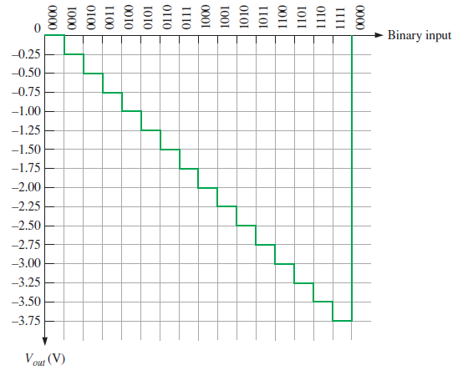
Binary Weighted DAC

Slide 7
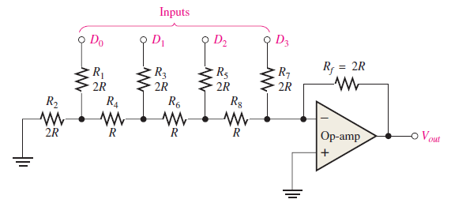
R-2R Ladder DAC
Though binary-weighted DAC is simple to understand, construction of it is hectic.
For binary-weighted DAC we need exact multiples of the resistors (R, 2R, 4R, 8R, 16R).
For DAC of higher bits, the construction becomes practically infeasible.
However, R-2R DAC solves this problem.
The construction only require resistors of value R and 2R

Slide 8
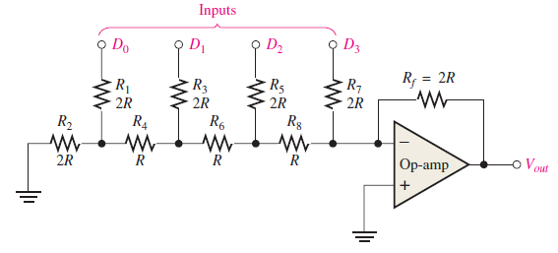
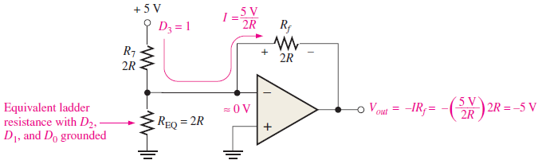
R-2R Ladder DAC
Contribution of D₃.

Slide 9
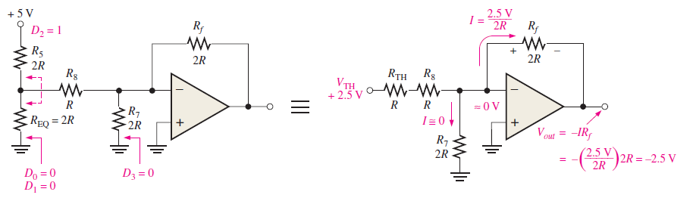
R-2R Ladder DAC
Contribution of D₂.

Slide 10
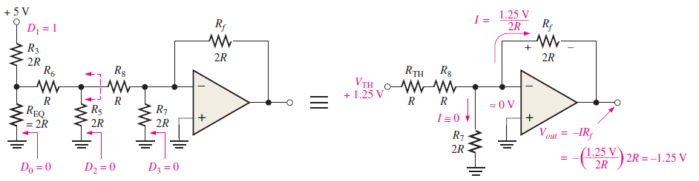
R-2R Ladder DAC
Contribution of D₁.

Slide 11
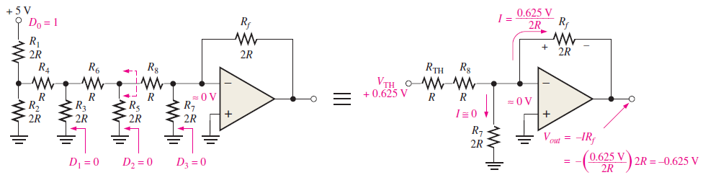
R-2R Ladder DAC
Contribution of D₀.

Slide 12
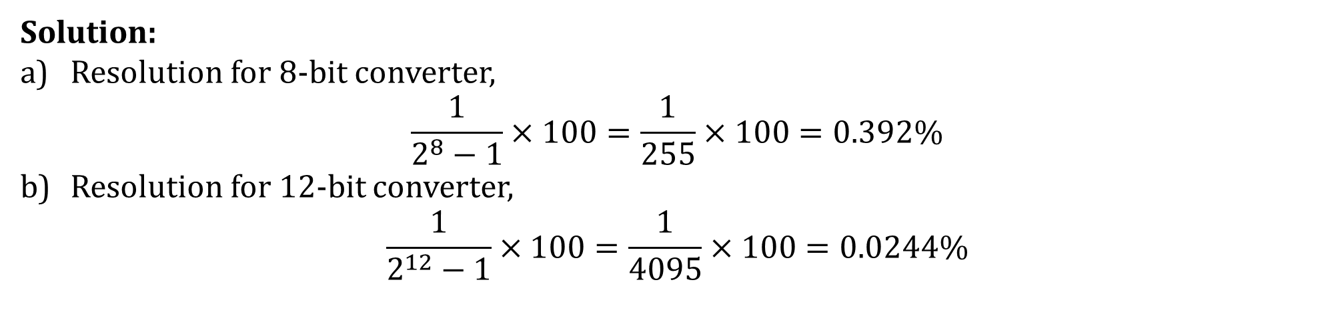
DAC
Resolution of a n-bit DAC:
$$\frac{1}{2^{n}−1}$$
Determine the resolution expressed as a percentage of the following:
An 8-bit DAC
A 12-bit DAC
Solution:
Resolution for 8-bit converter,
$$\frac{1}{2^{8}−1}×100=\frac{1}{255}×100=0.392\%$$
Resolution for 12-bit converter,
$$\frac{1}{2^{12}−1}×100=\frac{1}{4095}×100=0.0244\%$$

Slide 13
References
Thomas L. Floyd, “Digital Fundamentals” 11th edition, Prentice Hall – Pearson Education.
Thank You

